Slide 1
Probability and statistics
03-Bayes’ rule
상명대학교 휴먼지능정보공학과
2022년 2학기

Slide 2
Independence
Two events are independent if knowledge that one occurred does not change the probability that the other occurred.
Informally, events are independent if they do not influence one another.
A is independent of B if P(A|B) = P(A).
Formal definition of independence: Two events A and B are independent if
P(A ∩ B)= P(A) · P(B)

Slide 3
Example
Toss a fair coin twice. Let H1 = “heads on first toss” and let H2 = “heads on second toss”.
Are H1 and H2 independent?
Answer: Since H1 ∩ H2 is the event ‘both tosses are heads’ we have
P(H1 ∩ H2)=1/4= P(H1)P(H2).
Therefore the events are independent.

Slide 4
Question
Roll two dice and consider the following events
A = ‘first die is 3’
B = ‘sum is 6’
C = ‘sum is 7’
A is independent of
(a) B and C; (b) B alone; (c) C alone; (d) Neither B or C.

Slide 5
Bayes’ Theorem
Bayes’ theorem is a pillar of both probability and statistics and it is central to the rest of this course.
For two events A and B; Bayes’ theorem (also called Bayes’ rule and Bayes’ formula) says
P(B|A) = P(A|B) · P(B) / P(A)
Comments:
  1. Bayes’ rule tells us how to invert conditional probabilities, i.e. to find P(B|A) from P(A|B).
  2. In practice, P(A) is often computed using the law of total probability.

Slide 6
The Base Rate Fallacy
Consider a routine screening test for a disease. Suppose the frequency of the disease in the population (base rate) is 0.5%. The test is accurate with a 5% false positive rate and a 10% false negative rate.
You take the test and it comes back positive. What is the probability that you have the disease?
Answer: We’ll use the following notation for the relevant events:
D+ = you have the disease
D− = you do not have the disease
T+ = you tested positive
T− = you tested negative.
We are given P(D+) = .005 and therefore P(D−) = .995. The false positive and false negative rates are (by definition) conditional probabilities.
P(false positive) = P(T+ |D−) = .05 and P(false negative) = P(T− |D+) = .1

Slide 7
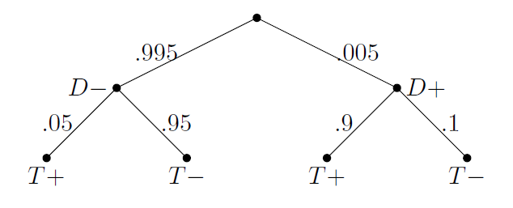
The Base Rate Fallacy (cont.)
We are given P(D+) = .005 and therefore P(D−) = .995. The false positive and false negative rates are (by definition) conditional probabilities.
P(false positive) = P(T+ |D−) = .05 and P(false negative) = P(T− |D+) = .1
The complementary probabilities are known as the true negative and true positive rates:
P(T− |D−) = 1 − P(T + |D−) = .95 and P(T+ |D+) = 1 − P(T− |D+) = .9.
In tree:
The question asks for the probability that you have the disease given that you tested positive, i.e. what is the value of P(D+|T+).

Slide 8
The Base Rate Fallacy (cont.)
In tree:
The question asks for the probability that you have the disease given that you tested positive, i.e. what is the value of P(D+|T+).
This can be solved by Bayes’ rule:
P(D+|T+) = P(T+|D+) · P(D+) / P(T+).
By the law of total probability:
P(T+) = P(T+|D+)P(D+) + P(T+|D-)P(D-) =.005*.9+.995*.05=0.05425.
P(D+|T+) = .995*.05/0.05425=0.083=8.3%
This is called the base rate fallacy because the base rate of the disease in the population is so low that the vast majority of the people taking the test are healthy, and even with an accurate test most of the positives will be healthy people.

Slide 9
Question
A 6-sided die is in one urn and a 8-sided die in the other.
Select one of the urns and covertly takes the die.
Roll the die in secret and reports the result.
Given the reported number, what is the probability that the 6-sided die was chosen? (Find the probability for each possible reported number 1~8.)
Answer: 4/7 for 1~6; 0 for 7, 8

